Slide 1
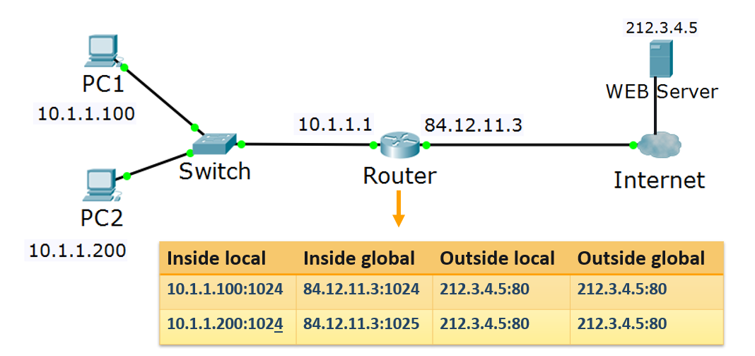
Access Control Lists. Network Address Translation
Module 3
SoftUni Team
Technical Trainers
Software University
http://softuni.bg

Slide 2
Questions
sli.do #NetAdvanced

Slide 3
Table of Contents
Access control lists overview
Access control lists configuration
Creating ACLs
Assigning ACLs
Network address translation
Demonstration

Slide 4
Access control lists overview

Slide 5

What is an ACL?
ACL: Access Control List
ACL is a list of rules – each of them is permit or deny
Created and applied on a Layer 3 device
A device with applied ACL acts like a firewall

Slide 6
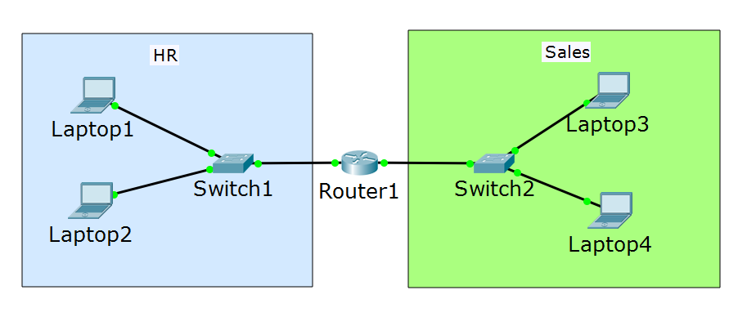
Why to implement ACLs?
ACLs filter the network traffic
Better security
Can increase the overall network performance
ACLs may just select traffic for other reasons:
Applying QoS
NAT
Traffic mirroring

Slide 7
ACL types
Standard ACLs – can filter only the source IP address of a packet
Extended ACLs – can filter based on:
Source and/or destination IP address
Source and/or port TCP/UDP number
IP protocol (DNS, FTP, HTTP, etc.)
Ethernet frame header ACLs
Filtering based on source or destination MAC address
Not very common

Slide 8
ACL process order
Test the packet against criteria in 1st rule
Is there a match?
Yes
Perform action: permit OR deny
End
No
Test the packet against criteria in 2nd rule
Is there a match?
Yes
Perform action: permit OR deny
End
No
Test the packet against criteria in Nth rule
Is there a match?
Yes
Perform action: permit OR deny
End
No
Packet is denied
End

Slide 9
Questions
sli.do #NetAdvanced

Slide 10
Access Control Lists configuration

Slide 11
Access Control Lists configuration
Creating ACLs

Slide 12
Standard ACLs configuration
ip access-list standard [<1-99> or name]
[permit or deny] network [wildcard mask ] or any or host
Examples:
ip access-list standard test_standard
permit 192.168.1.0 0.0.0.255 (the whole 192.168.1.X network)
deny host 10.1.1.1 (only the host with IP 10.1.1.1 matches here)
deny host 172.16.34.15 (the exact 172.16.34.15 host)
permit any (anything else which did not match before)
deny any (do not forget the implicit deny at the end of each ACL!)

Slide 13
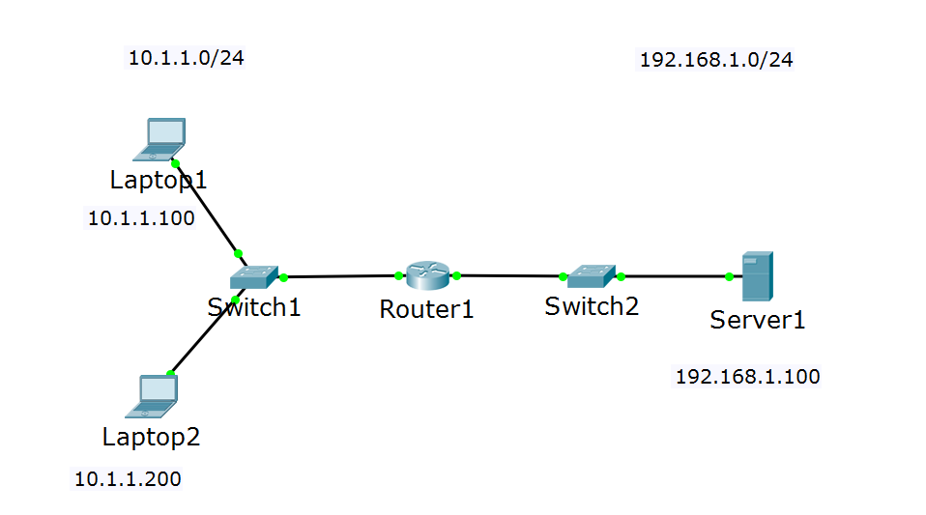
ACL process order – example 1 with standard ACL
Q: Is Laptop1 allowed to reach Server1?
A: No
Q: Is Laptop2 allowed to reach Server1?
deny host 10.1.1.100
(deny any)
A: No
*An ACL must also be applied to an interface, this is discussed in the next section

Slide 14
ACL process order – example 2 with standard ACL
Q: Is Laptop1 allowed to reach Server1?
A: No
Q: Is Laptop2 allowed to reach Server1?
A: Yes
deny host 10.1.1.100
permit host 10.1.1.200
(deny any)

Slide 15
ACL process order – example 3 with standard ACL
Q: Is Laptop1 allowed to reach Server1?
A: No
Q: Is Laptop2 allowed to reach Server1?
A: Yes
deny host 10.1.1.100
permit 10.1.1.0 0.0.0.255
(deny any)

Slide 16
ACL process order – example 4 with standard ACL
Q: Is Laptop1 allowed to reach Server1?
A: Yes
Q: Is Laptop2 allowed to reach Server1?
A: Yes
permit 10.1.1.0 0.0.0.255
deny host 10.1.1.100
(deny any)

Slide 17
ACL process order – example 5 with standard ACL
Q: Is Laptop1 allowed to reach Server1?
A: No
Q: Is Laptop2 allowed to reach Server1?
A: No
permit 10.1.2.0 0.0.0.255
(deny any)

Slide 18
ACL process order – example 6 with standard ACL
Q: Is Laptop1 allowed to reach Server1?
A: Yes
Q: Is Laptop2 allowed to reach Server1?
A: Yes
deny 15.1.2.0 0.0.0.255
permit any any
(deny any)

Slide 19
Extended ACLs configuration
ip access-list extended [<100-199> or name]
[permit or deny] protocol [source] network or any or host [destination] network or any or host
Examples:
ip access-list extended test_extended
deny ip host 10.1.1.1 host 20.2.2.2
permit tcp 10.12.12.0 0.0.0.255 host 20.2.2.2 eq www
deny icmp any 172.16.0.0 0.0.255.255 echo
deny ip any any (do not forget the implicit deny at the end of each ACL)

Slide 20
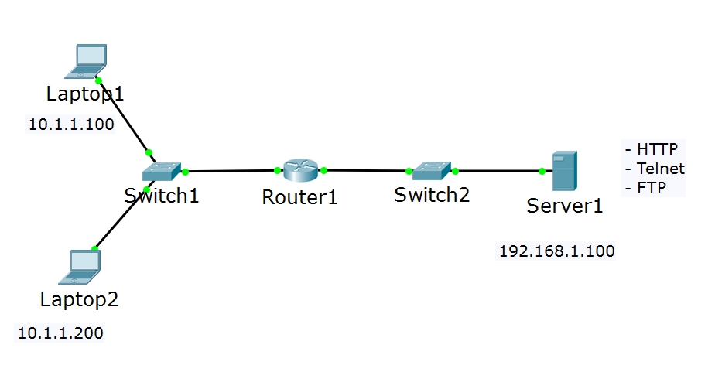
ACL process order – example 1 with extended ACL
Q: Is Laptop1 allowed to reach Server1?
A: Yes
Q: Is Laptop2 allowed to reach Server1?
A: No
deny ip host 10.1.1.200 host 192.168.1.100
permit ip any any
(deny ip any any)

Slide 21
ACL process order – example 2 with extended ACL
Q: Is Laptop1 allowed to reach a web page on Server1?
A: Yes
Q: Can Laptop1 ping Server1?
A: No
Q: Is Laptop1 allowed to reach Telnet and FTP on Server1?
A: No
deny ip host 10.1.1.200 host 192.168.1.100
permit tcp host 10.1.1.100 host 192.168.1.100 eq 80
(deny ip any any)

Slide 22
Access Control Lists configuration
Assigning ACLs

Slide 23
Assigning ACLs
An ACL in the configuration has zero effect if it is not assigned to interface
ACLs can be assigned to interfaces inbound or outbound

Slide 24
Assigning ACLs - inbound
ACL is assigned for inbound traffic

Slide 25
Assigning ACLs - outbound
ACL is assigned for outbound traffic

Slide 26
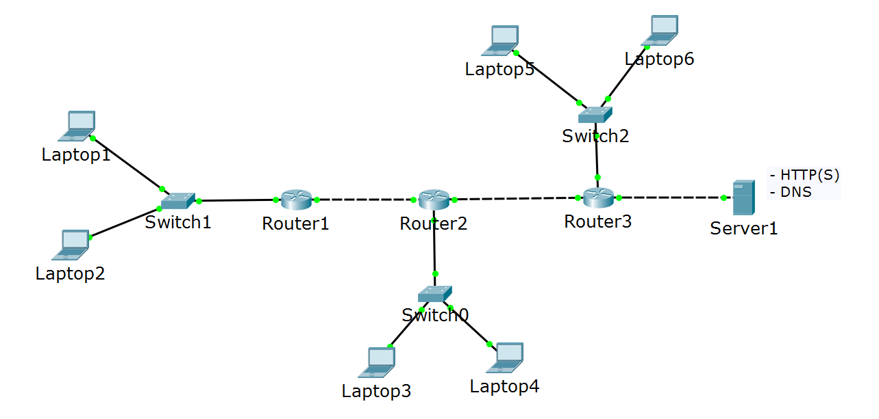
Assigning ACLs – best practices
deny HTTP only from Laptop1

Slide 27
Assigning ACLs – best practice for standard ACLs
deny HTTP only from Laptop1

Slide 28
Assigning ACLs – best practice for extended ACLs
deny HTTP only from Laptop1

Slide 29
Questions
sli.do #NetAdvanced

Slide 30
Network address translation

Slide 31
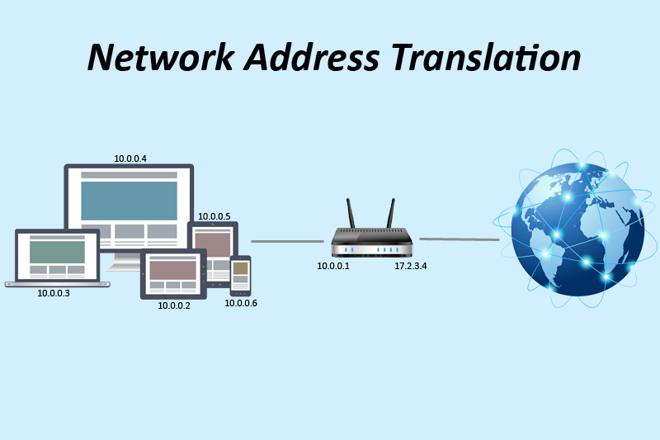
What is NAT?
NAT: Network Address Translation
Used to change the source and/or destination IP address of the packets

Slide 32
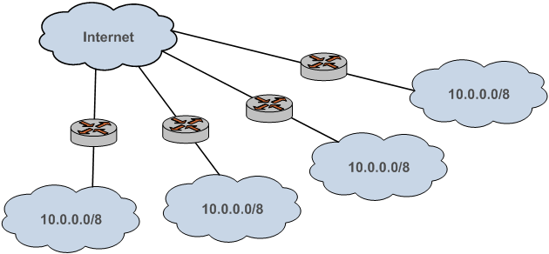
Why NAT?
Primary idea – to solve the “not enough IPv4 addresses” problem
There are only ≈ 4 billion addresses (in IPv4) – quite insufficient for the huge number of Internet users
NAT allows the private addresses to be reused since they are not routed in Internet

Slide 33
Types of NAT
Source NAT
Destination NAT
Bidirectional NAT

Slide 34
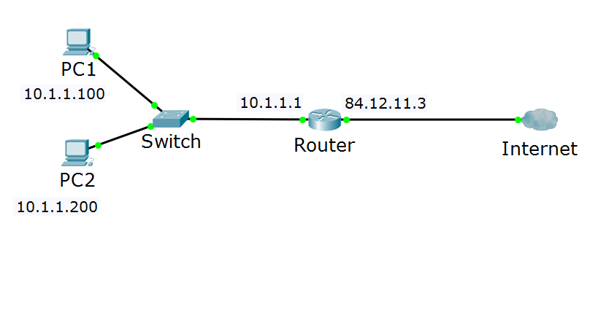
Source NAT (SNAT)
Source: 10.1.1.100
Destination: 212.3.4.5
Source: 84.12.11.3
Destination: 212.3.4.5
SNAT

Slide 35
Destination NAT (DNAT)
Source: 212.3.4.5
Destination: 10.1.1.100
DNAT
Source: 212.3.4.5
Destination: 84.12.11.3

Slide 36
Bidirectional NAT
SNAT
Source: 84.12.11.3
Source: 10.1.1.100
Destination: 10.1.1.100
DNAT
Destination: 84.12.11.3

Slide 37
NAT terminology
Inside local address - assigned to a host on the inside network, typically private IP address
Inside global address - a public, legitimate IP address that represents one or more inside local addresses to the outside world
Outside local address - IP address of an outside host as it appears to the inside network (can be private address)
Outside global address – public address assigned to a host on the outside network

Slide 38
NAT vs PAT
PAT: Port Address Translation
In NAT, 1 private address is translated to 1 public address
In PAT, multiple private addresses are translated to 1 public
PAT creates a table which matches: Inside local:source_port -> Inside global:unique_source_port
This way PAT knows to which exact internal host should forward the returning traffic

Slide 39
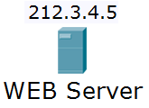
PAT – example 1
Inside local | Inside global | Outside local | Outside global
10.1.1.100:1024 | 84.12.11.3:1024 | 212.3.4.5:80 | 212.3.4.5:80
10.1.1.200:1025 | 84.12.11.3:1025 | 212.3.4.5:80 | 212.3.4.5:80

Slide 40
PAT – example 2
Inside local | Inside global | Outside local | Outside global
10.1.1.100:1024 | 84.12.11.3:1024 | 212.3.4.5:80 | 212.3.4.5:80
10.1.1.200:1024 | 84.12.11.3:1025 | 212.3.4.5:80 | 212.3.4.5:80

Slide 41
NAT configuration – define the interfaces
ip nat inside
ip nat outside

Slide 42
NAT configuration – define the translations
ip nat inside source list command:
translates the source of IP packets that are traveling inside to outside
translates the destination of the IP packets that are traveling outside to inside
ip nat outside source list command:
translates the source of the IP packets that are traveling outside to inside
translates the destination of the IP packets that are traveling inside to outside
*The first command is used much more often than the second one

Slide 43
Questions
sli.do #NetAdvanced

Slide 44
Demonstration

Slide 45


Slide 46

Summary
Access control lists overview
Access control lists configuration
Creating ACLs
Assigning ACLs
Network address translation
Demonstration
…
…
…

Slide 48






СофтУни диамантени партньори

Slide 49






СофтУни диамантени партньори

Slide 50





Trainings @ Software University (SoftUni)
Software University – High-Quality Education, Profession and Job for Software Developers
softuni.bg
Software University Foundation
http://softuni.foundation/
Software University @ Facebook
facebook.com/SoftwareUniversity
Software University Forums
forum.softuni.bg

